Slide 1

Resume Classification
Team 4

Slide 2
Team members
MENTOR’S NAME : Mr.Abisheka Kavuri
TEAM MEMBERS:
Mr. Rahul Kumar Dubey
Mr. Prasanth G
Mr. Chaitanya
Ms. Gaganasindhu Y Hadagali
Mr. Prajwal Ambure
Mr. Hari Prasath P
Ms. Akanksha Bhalerao

Slide 3
Business Objective
The document classification solution should significantly reduce the manual human effort in the HRM .It should achieve a higher level of accuracy and automation with minimal human intervention.

Slide 4
DATASET DETAILS
The dataset used in this project consists of resumes collected in document format and organized into category-wise folders.
Each resume belongs to one of four job roles: Peoplesoft Resume, React Developer, SQL Developer, and Workday, which act as the target classes.
The resumes contain unstructured textual information such as skills, experience, education, and technical keywords.
After text extraction, the data was converted into a structured dataset with clearly defined resume text and corresponding job category labels.
The dataset was verified for quality and completeness, and no missing values were found.
This clean and well-labeled dataset makes it suitable for Natural Language Processing and supervised machine learning models.

Slide 5
Project architecture
Data Collection
Business Understanding
Exploratory Data Analysis(EDA)
Deployment
Model Building

Slide 6
TEXT extRACTion
Text extraction is the first and most important step in this project, where raw resume documents are converted into machine-readable text.
Resumes are collected in DOC and DOCX formats and processed automatically to extract their textual content.
This step transforms unstructured resume files into structured data suitable for analysis and modeling.

Slide 7
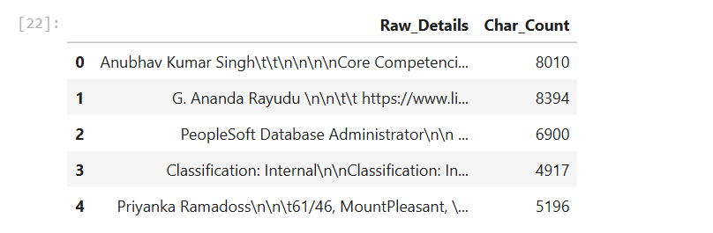
CHARACTER COUNT ANALYSIS
Character count was computed to measure the total size of each extracted resume, including spaces.
The results show that resumes range between approximately 5,000 and 8,000 characters.
This confirms that important resume content has been preserved during extraction.

Slide 8
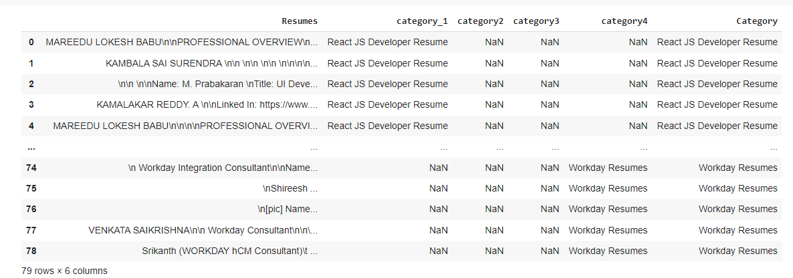
Merging all category files.

Slide 9
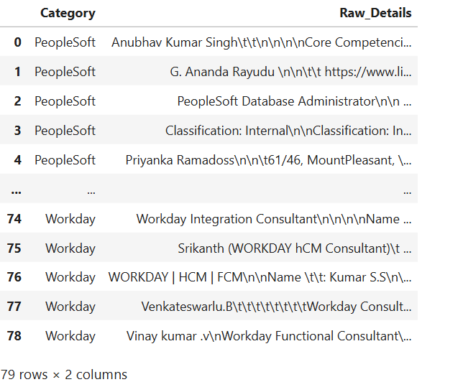
Converting text to .csv (Process)

Slide 10
EDA OVERVIEW
Exploratory Data Analysis is performed to understand the structure, quality, and characteristics of the extracted resume dataset.
This step helps identify patterns, variations in resume length, and data readiness before model building.
EDA ensures that the dataset is suitable for Natural Language Processing and machine learning techniques.

Slide 11
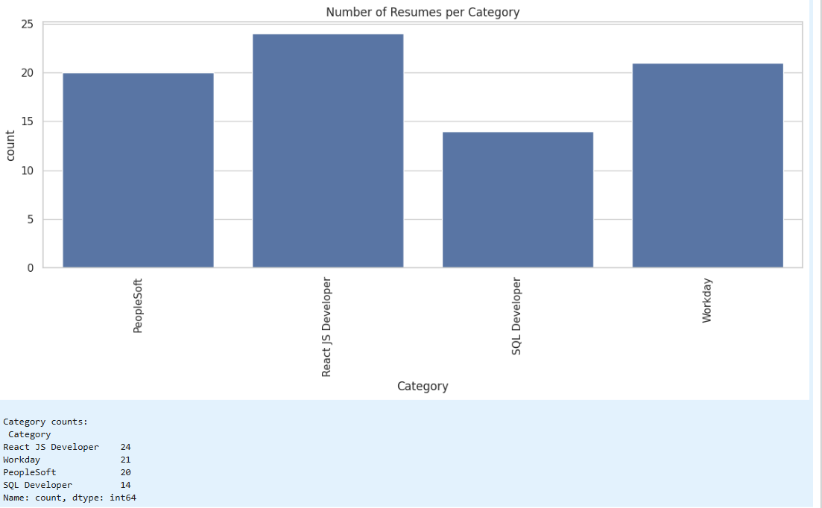
DATASET CATEGORIES
The dataset contains four distinct job categories extracted from resume folders.
These categories include Peoplesoft Resume, React Developer, SQL Developer, and Workday.
This confirms that resumes are clearly labeled for supervised classification.

Slide 12
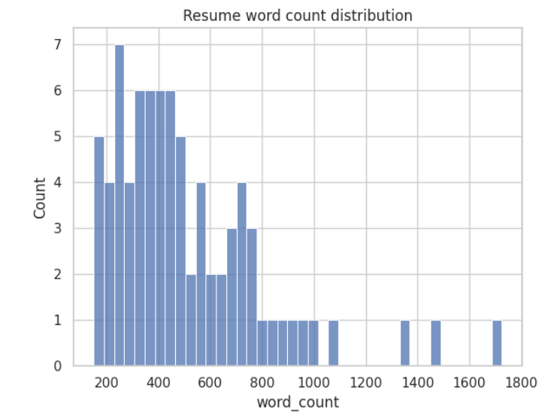
WORD COUNT DISTRIBUTION
This slide shows the distribution of resumes based on the number of words present in each resume.
The graph indicates that most resumes contain a substantial number of words, while a few resumes are comparatively shorter or longer.
This variation highlights differences in resume writing styles and experience levels.

Slide 13
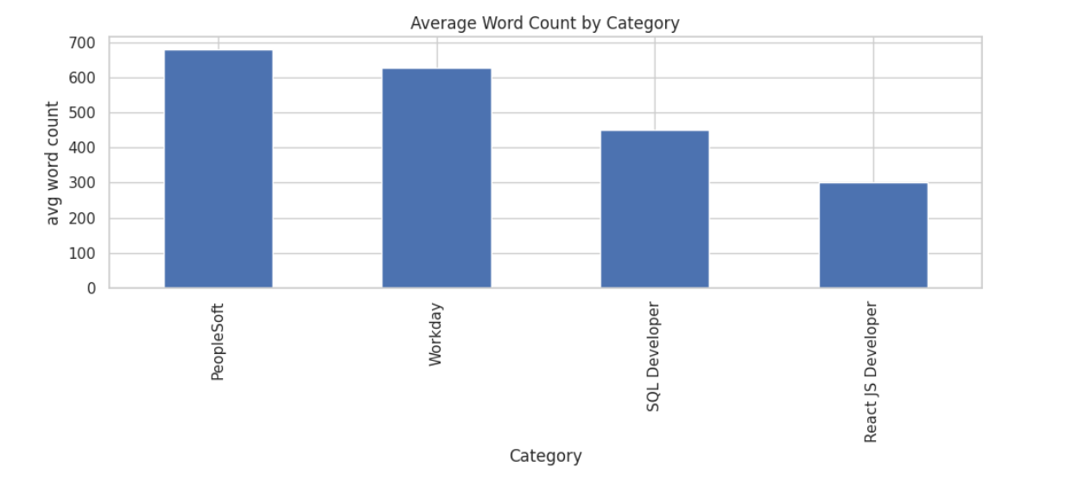
AVERAGE WORD COUNT
This slide shows the average word count across all resumes in the dataset.
The average value indicates that resumes are sufficiently descriptive and information-rich.
This confirms that the dataset is suitable for TF-IDF and NLP processing.

Slide 14
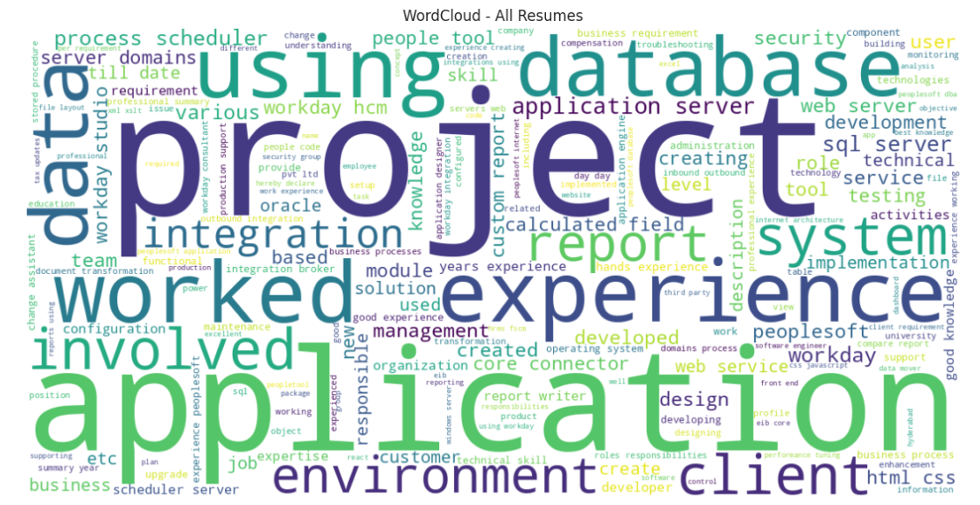
WORD CLOUD FOR ALL RESUMES
The word cloud visually represents the most frequently occurring words across all resumes.
It highlights common skills, technologies, and domain-related keywords.
This provides an intuitive understanding of dominant terms in the dataset.

Slide 15
MODEL BUILDING OVERVIEW
Model building is the stage where machine learning algorithms are trained to classify resumes into job categories.
In this phase, the processed resume text is converted into numerical features and used to train multiple classification models.
The goal is to identify the model that provides the best performance.

Slide 16
FEATURE EXTRACTION USING TF-IDF
TF-IDF vectorization is used to transform resume text into numerical features.
This technique assigns higher importance to relevant words while reducing the effect of commonly occurring terms.
It helps machine learning models effectively learn patterns from textual data.

Slide 17
MODEL EVALUATION OVERVIEW
Multiple machine learning models were trained and evaluated to identify the best classifier for resume classification.
Each model was tested using standard performance metrics such as accuracy, precision, recall, and F1-score.
This comparison helps ensure that the final model is both accurate and reliable.

Slide 18
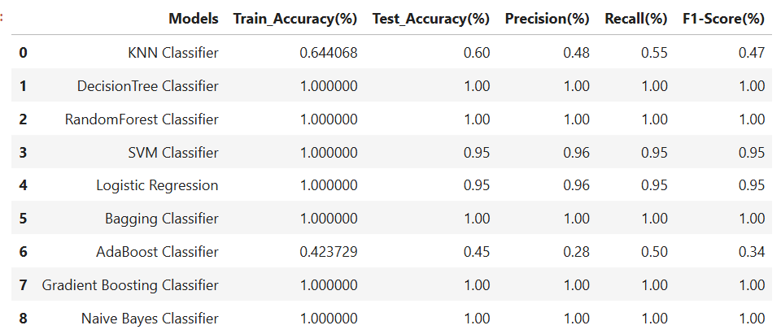
MODEL PERFORMANCE COMPARISON
This slide presents a comparison of multiple classifiers including KNN, Decision Tree, Random Forest, SVM, Logistic Regression, and ensemble models.
The table shows both training and testing performance along with precision, recall, and F1-score.
This provides a complete view of how each model performs on unseen data.

Slide 19
LOW & MODERATE PERFORMING MODELS
KNN and AdaBoost classifiers show comparatively lower test accuracy and F1-score.
This indicates that these models are not able to capture resume text patterns effectively.
Such models were therefore not considered suitable for final deployment.

Slide 20
REASON FOR HIGH ACCURACY IN MULTIPLE MODELS
Several machine learning models achieved very high or perfect accuracy because the resume dataset is well-structured and clearly labeled.
The job categories contain distinct keywords and skill patterns, which makes them easily separable by tree-based and probabilistic models.
This clear separation allows models like Decision Tree, Random Forest, and Naive Bayes to classify resumes very effectively.
FINAL MODEL SELECTION
The Decision Tree classifier was selected as the final model for deployment.
It achieved perfect training and testing accuracy along with precision, recall, and F1-score of 1.00.
Additionally, it provides easy interpretability, making it suitable for real-world HR applications.

Slide 21
DEPLOYMENT OVERVIEW
The deployment phase converts the trained resume classification model into a usable application.
It allows users to upload resumes and receive job category predictions in real time.
This step bridges the gap between model development and real-world HR usage.

Slide 22
APPLICATION FUNCTIONALITY & BENEFITS
The deployed application supports resume uploads and automatically predicts the relevant job role.
It reduces manual screening effort and speeds up the recruitment process.
The system is efficient, scalable, and easy to use for HR professionals.

Slide 23
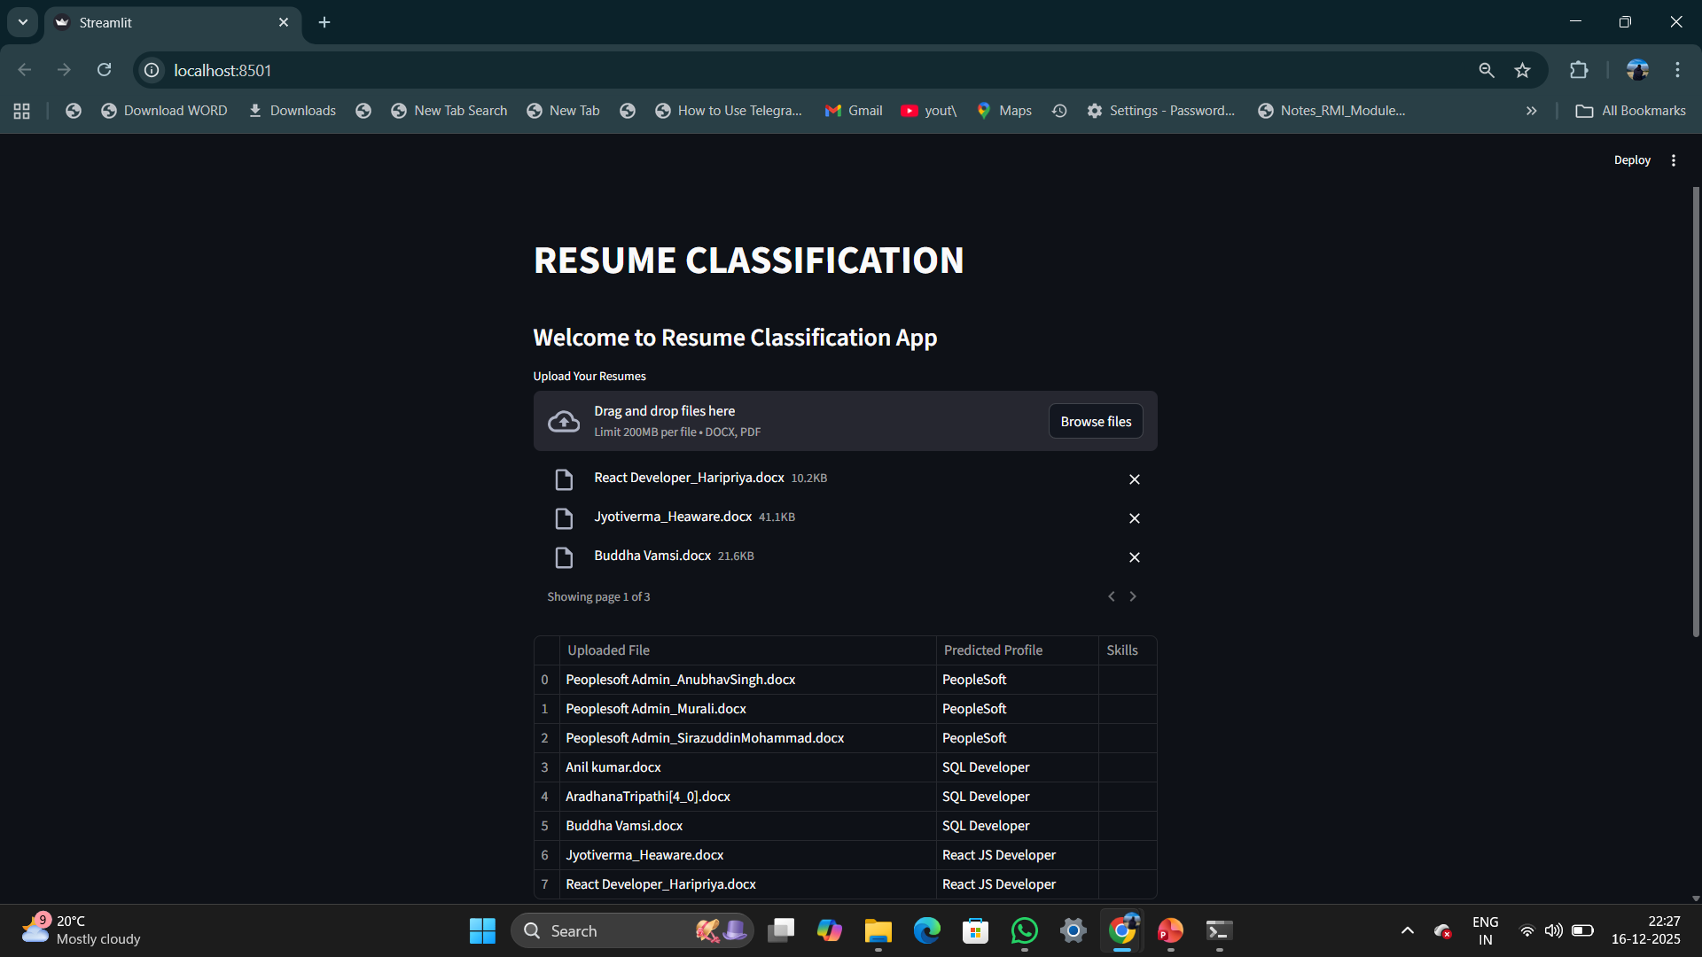
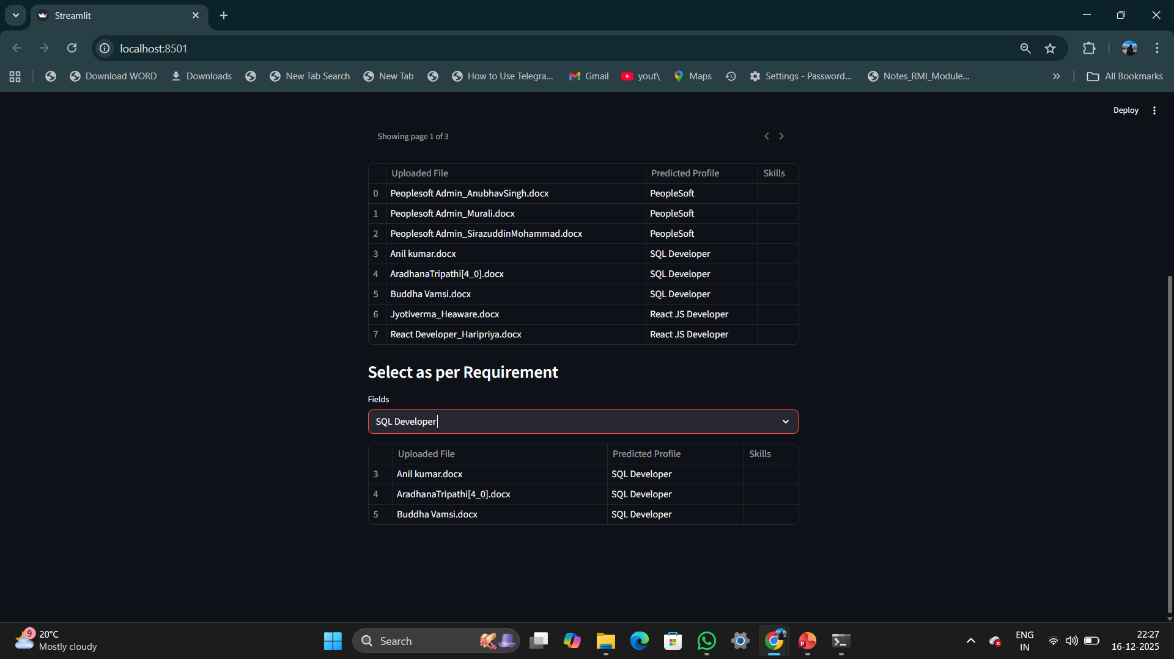
APPLICATION INTERFACE
The working interface of the deployed resume classification system.
The interface is simple and interactive, allowing quick resume uploads and result viewing.
It demonstrates the practical usability of the developed solution.

Slide 24
CHALLENGES FACED DURING THE PROJECT
Our major challenge was handling resumes with different formats, layouts, and writing styles, which affected text extraction consistency.
Special characters, extra spaces, and formatting noise required careful preprocessing to ensure clean textual data.
Another challenge was selecting the most suitable machine learning model when multiple models showed very high accuracy.
Avoiding overfitting and ensuring the model generalized well to unseen resumes was an important consideration.
Finally, deploying the model in a user-friendly application without exposing technical complexity required careful design.
Despite these challenges, all issues were successfully addressed through systematic preprocessing, evaluation, and testing.

Slide 25


